Slide 1

SQL QUERY GENERATION USING GENERATIVE AI
GEN-AI Domain Mini Project 2024-2025
Name | Division | USN | Roll No.
Aradhya Gaonkar | F | 01FE22BCI019 | 117
Aryan Phadnis | A | 01FE22BCS126 | 123
Vignesh Chowgule | F | 01FE22BCI007 | 107
Sheldon Pereira | C | 01FE22BCS022 | 304
Under the Guidance of Prof. K M M Rajashekaraiah

Slide 2


PROJECT MOTIVATION
1
Underutilization of Knowledge Sources:
Large amounts of valuable information from textbooks, research papers, and documents are not easily accessible for direct use in databases.
Complexity of SQL Query Generation:
Writing SQL queries and manipulating databases requires expertise, creating a barrier for non-technical users.
Limited Accessibility to Non-Experts:
Many professionals outside of data science or programming fields struggle to effectively interact with databases.
Inefficiency in Knowledge Application:
There’s no seamless way to translate domain-specific knowledge into actionable database operations.
We believe that a Retrieval-Augmented Generation (RAG) system, integrated with LLMs, can solve these issues by automating SQL query generation, making knowledge from various sources easy to retrieve and apply.
This will simplify database interactions and make data manipulation accessible to a wider audience.
GEN-AI

Slide 3

PROBLEM STATEMENT
2
PS (as per Domain Project List):
Design a tool that generates code snippets based on natural language descriptions or project requirements. The project could be particularly useful for automating repetitive coding tasks.
Key Learning Outcomes: NLP, deep learning, and the practical application of Al in software development.
Specifically Targeting
Project Objectives:
Simplify database interaction.
Automate SQL query generation.
Integrate external knowledge.
Enhance data accessibility.
Improve efficiency.

Slide 4
LITERATURE SURVEY
3

Slide 5

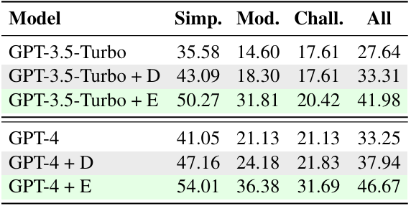
Knowledge-to-SQL: Enhancing SQL Generation with Data Expert LLM
TM
Problem Statement: Generating accurate SQL from natural language requires understanding both user intent and the database schema. Large language models often fail when key schema details are missing, particularly in complex queries, leading to inaccurate or unusable SQL.
:using PLDBF, which evaluates the generated SQL based on the correctness of its execution and contribution to query accuracy.
SQL Generation: The refined DELLM generates expert knowledge, which is then integrated into the SQL generation process by off-the-shelf text-to-SQL models like GPT-3.5-Turbo or GPT-4.
Results : The experimental results show that incorporating DELLM-generated knowledge improves execution accuracy (EX) and valid efficiency score (VES) across different models: GPT-3.5-Turbo: +5.67% EX, +7.48% VES GPT-4: +4.69% EX, +6.23% VES The results indicate that DELLM improves the performance of even advanced SQL generation models like GPT-4, especially in handling complex or domain-specific queries​(2402.11517v3).
Methodology:
Table Reading: Relevant tables from the database are selected using semantic similarity to the user’s query.
Supervised Fine-tuning (SFT): DELLM generates expert knowledge based on the query and database schema to assist in SQL generation.
Preference Learning via Database Feedback (PLDBF): Feedback is provided based on how well the generated SQL performs, refining DELLM’s knowledge generation capabilities through database execution and ground-truth SQL comparison.
Objective::
To develop a framework that automatically generates expert knowledge to improve text-to-SQL accuracy.
To enhance SQL generation for complex, real-world database queries by incorporating domain-specific and expert-level knowledge without requiring human input.
To create a robust, open-source tool for further research and application in SQL generation tasks.
Conclusion : The Knowledge-to-SQL framework significantly enhances the accuracy and efficiency of SQL generation by large language models. Through the integration of DELLM and its ability to provide expert knowledge, the system is capable of bridging knowledge gaps between the user's natural language query and the underlying database schema. The results demonstrate the effectiveness of the model across multiple datasets, showing considerable improvements in execution accuracy and efficiency.
Implementation :
Supervised Fine-Tuning: This involves training DELLM on a dataset of user queries, associated schemas, and expert-annotated knowledge. The SFT process matches queries to relevant sub-tables and generates the required knowledge.
Preference Learning: After SFT, the model is further refined
References:
Zijin Hong and Jian Liu. 2024. Towards better ques tion generation in qa-based event extraction. arXiv preprint arXiv:2405.10517.
OpenAI. 2023. Gpt-4 technical report. arXiv preprint arXiv:2303.08774.

Slide 6
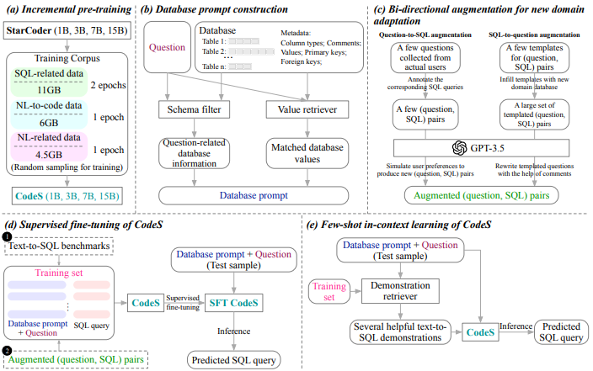
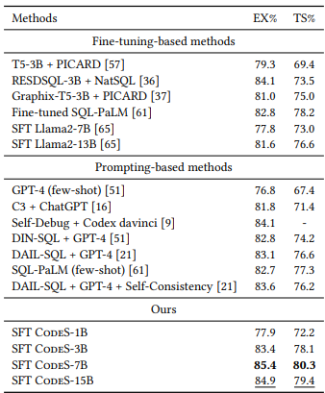
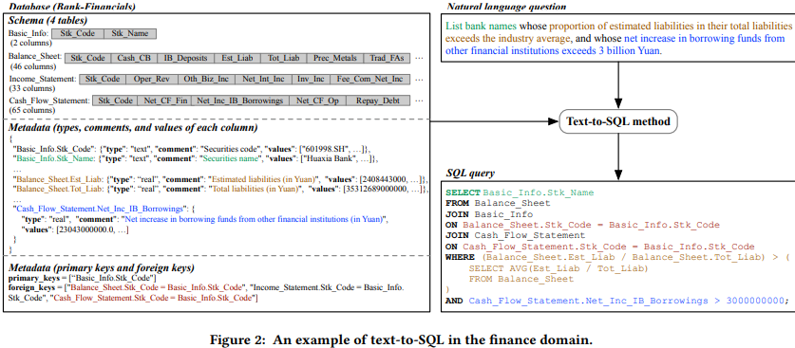
CodeS: Towards Building Open-source Language Models for Text-to-SQL
By: Haoyang Li, Jing Zhang, Hanbing Liu , Ju Fan , Xiaokang Zhang , Jun Zhu , Renjie Wei , Hongyan Pan , Cuiping Li , Hong Chen
TM
Problem Statement : Addressing the limitations of closed-source LLMs for Text-to-SQL with an efficient, open-source alternative.
Implementation:
Figure 3: Illustration of the comprehensive framework
CodeS that is incrementally pre-trained on top of StarCoder using our specially curated SQL-focused dataset.
Our unique method for database prompt construction.
The proposed bi-directional data augmentation technique for adapting to new domains. CodeS can be employed in two distinct manners:
1. Inferring after a supervised fine-tuning of CodeS on a training dataset, sourced from text-to-SQL benchmarks along with our enriched (question, SQL) pairs.
2. Direct inference through few-shot in-context learning on CodeS.
Results: SFT CodeS-3B outperforms the leading GPT4-based method (i.e., DIN-SQL and DAIL-SQL), illustrating the potential of smaller models to excel as text-to-SQL parsers after finetuning. SFT CodeS-7B and SFT CodeS-15B achieve new SOTA performance on Spider’s development set. SFT CodeS-15B demonstrates strong generalization, achieving near SOTA results while remaining significantly smaller than closed-source models like GPT-4.
Methodology:
Incremental pre-training on a curated SQL-related dataset to enhance SQL reasoning.
Schema filtering to handle schema linking (matching database elements with user queries).
Bi-directional data augmentation for generating more text-to-SQL training data in various domains.
Use of smaller LLMs (1B-15B parameters) for efficiency and reduced computational costs.
Objective: To develop an efficient, open-source LLM (CodeS) for Text-to-SQL tasks, to overcome the limitations of existing closed-source models by reducing computational costs, enhancing privacy, and improving adaptability but with state-of-the-art performance on SQL generation results.
References:
Li, H., Zhang, J., Liu, H., Fan, J., Zhang, X., Zhu, J., Wei, R., Pan, H., Li, C., & Chen, H. CodeS: Towards Building Open-source Language Models for Text-to-SQL (2024). arXiv:2402.16347. https://arxiv.org/abs/2402.16347
Conclusion: CodeS achieves state-of-the-art or better results on key text-to-SQL benchmarks (e.g., Spider), outperforming some large closed-source models in certain aspects while offering significant advantages in efficiency, cost, and is also open-source.

Slide 7
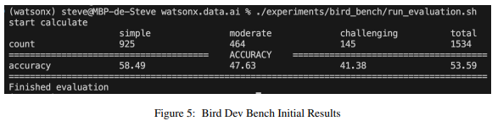
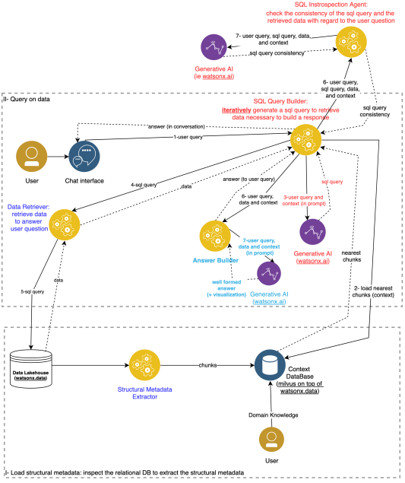
Natural Language Query Engine for Relational Databases using Generative AI
By: Steve Tueno Fotso
TM
Problem Statement : Developing a natural language query engine that accurately translates user queries into SQL while integrating complex business rules and also ensuring syntactic and semantic correctness.
Implementation:
Technology Stack:
Milvus Vector Database: Used to store vectorized representations of the database schema and business rules.
IBM watsonx.data: Acts as the relational database, using its SQL engine (Presto) to handle database queries.
IBM watsonx.ai: Provides Large Language Models (LLMs) like LLama 3 and Mixtral for natural language processing, SQL generation, and natural language responses.
Python for Orchestration: Manages interactions between components and powers the frontend (Streamlit) for user interaction.
SQL Generation and Validation:
SQL Generation: LLMs generate SQL queries based on user input and database structure.
Validation: Ensures the SQL is correct both syntactically (SQL syntax) and semantically (align business rules).
Prototyping and Evaluation:
The system was tested using the BIRD Benchmark to assess its ability to handle various queries, including complex ones with multi-table joins and business rules.
Results: Accuracy on Different Difficulty Levels: The system was tested using the Bird Dev Bench and got an overall accuracy of 53.59%. It worked best with easy queries, getting 58.49% accuracy, while for medium difficulty queries it got 47.63%, and for harder ones it dropped to 41.38%. Testing on IBM’s watsonx Platform: When tested on IBM's watsonx.data and watsonx.ai platforms, the system showed good results, with more than 50% of the queries being correct. Over 90% of the responses in natural language were rated as "excellent" by users who were not technical experts, showing that users were happy with the results.
Methodology:
Figure 4: Architecture of the Prototype of the Natural Language Assistant for Relational Databases
The system first analyzes and vectorizes the database schema (tables, columns, relationships) and stores it in a vector database for quick retrieval during query processing.
Business rules are embedded into the query generation process by vectorizing domain-specific rules and applying them dynamically during SQL generation.
Generated SQL queries go through multiple validation steps—both syntactic and semantic—with iterative adjustments, ensuring accurate results
Objective: To develop a natural language query engine for relational databases using generative AI, which translates user queries into SQL, ensuring syntactic and semantic correctness while also integrating business rules for accurate data retrieval and response generation​.
References:
Fotso, S. T. Natural Language Query Engine for Relational Databases using Generative AI (2024). arXiv:2410.07144. https://arxiv.org/abs/2410.07144
Conclusion: The system makes use of generative AI and vector databases to enable intuitive, natural language querying of relational databases, ensuring SQL accuracy and semantic correctness while enhancing accessibility for all users including people who aren’t familiar with technology.

Slide 8
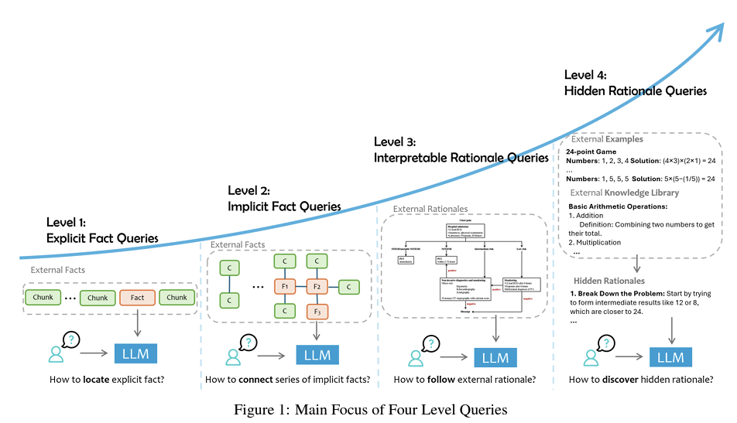
Retrieval Augmented Generation (RAG) and Beyond: A Comprehensive Survey on How to Make your LLMs use External Data More Wisely
TM
PS: Challenges in deploying LLMs in specialized fields arise due to model hallucinations, lack of domain-specific knowledge, and limitations in reasoning. Incorporating external data using techniques like (RAG) offers solutions with data retrieval, model alignment with user intent, and effective reasoning.
Implementation:
Fine-tuning LLMs using domain-specific data to adapt to specialized tasks.
RAG integration: Use of context injection, smaller models, or full model fine-tuning.
Iterative Retrieval: Enhance accuracy by refining retrievals in stages.
Results: RAG significantly improves performance in domain-specific tasks, reducing hallucinations and increasing the interpretability and controllability of the models. Case studies in finance and healthcare show marked improvement in LLM's ability to handle complex reasoning and domain knowledge.
Methodology:
Task Categorization: Queries are classified into four levels: Explicit Facts, Implicit Facts, Interpretable Rationales, and Hidden Rationales, each requiring different techniques for LLM integration.
Techniques:
RAG with Retrieval: Indexing, sparse and dense retrieval techniques.
RAG with Graph/Tree Structures: Multi-step reasoning and retrieval from knowledge graphs.
SQL Queries: Converting natural language queries into SQL for structured data interaction.
Figure 4: Architecture of the Prototype of the Natural Language Assistant for Relational Databases
The system first analyzes and vectorizes the database schema (tables, columns, relationships) and stores it in a vector database for quick retrieval during query processing.
Business rules are embedded into the query generation process by vectorizing domain-specific rules and applying them dynamically during SQL generation.
Generated SQL queries go through multiple validation steps—both syntactic and semantic—with iterative adjustments, ensuring accurate results
Objectives:
Develop a robust framework that augments LLM capabilities using domain-specific data.
Reduce hallucinations and enhance performance in complex, multi-hop reasoning tasks.
Create a tool to assist in RAG-based LLM development.
Conclusion: RAG techniques enable LLMs to address domain-specific challenges by integrating external data. Fine-tuning and iterative retrieval approaches help the models better understand user intent and perform complex reasoning tasks, proving the value of RAG for specialized domains.
References: https://arxiv.org/abs/2409.14924

Slide 9
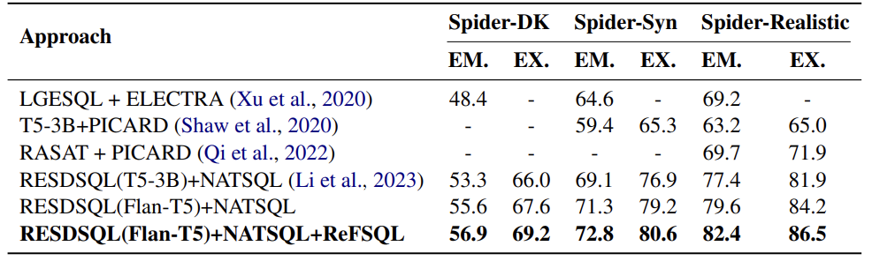
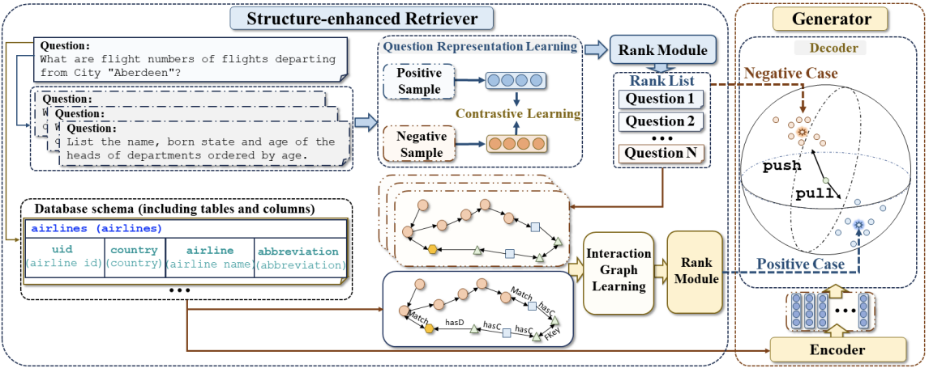
ReFSQL: A Retrieval-Augmentation Framework for Text-to-SQL Generation
By: Kun Zhang, Xiexiong Lin , Yuanzhuo Wang , Xin Zhang , Fei Sun , Jianhe , Xuhui Jiang , Hexiang Tan , Huawei Shen
TM
Problem Statement :Improving natural language to SQL conversion by mitigating errors arising from SQL's structural complexities. Existing models often struggle with capturing SQL-specific features. ReFSQL aims to enhance accuracy by incorporating retrieval-augmented techniques and contrastive learning
Implementation :
Uses BERT to encode question representations.
Enhances retrieval by calculating Tree-Edit Distance (TED) to find SQL similarity and by constructing interaction graphs with schema linking.
Uses Maximum Likelihood Estimation (MLE) to learn SQL token prediction.
Mahalanobis Contrastive Learning minimizes the distance between a sample and its retrieved similar examples, optimizing representations towards similar distributions.
Results : The results in the paper indicate that ReFSQL outperforms existing models on various benchmarks, achieving state-of-the-art performance for text-to-SQL generation. It notably improved metrics like exact-set-match (EM) and execution accuracy (EX) on datasets like Spider and WikiSQL.
:
Methodology:
Structure-Enhanced Retriever: Identifies similar samples based on question semantics and schema structure to provide SQL examples that improve model accuracy.
Generator: Aims to bridge the gap between specific and general knowledge
Objective:
Improve Text-to-SQL Generation: Address the gap between specific and general knowledge to reduce structural errors in SQL queries.
Leverage Retrieval-Augmentation: Use a retriever to bring in similar SQL examples to improve generation.
Fig2. Evaluation results on Spider-DK, Spider-Syn, and Spider-Realistic datasets, showing superior performance of RESDSQL(Flan-T5)+NATSQL+ReFSQL.
Conclusion : ReFSQL enhances text-to-SQL generation by bridging the gap between general and specific knowledge using retrieval-augmentation and Mahalanobis contrastive learning. It outperforms existing models, achieving state-of-the-art accuracy and robustness across benchmark datasets.
References:
Ting Chen, Simon Kornblith, Mohammad Norouzi, and Geoffrey Hinton. 2020. A simple framework for contrastive learning of visual representations. Link
Roy De Maesschalck, Delphine Jouan-Rimbaud, and Désiré L Massart. 2000. The mahalanobis distance. Chemometrics and intelligent laboratory systems,. Link
Fig1. The overall architecture of ReFSQL

Slide 10
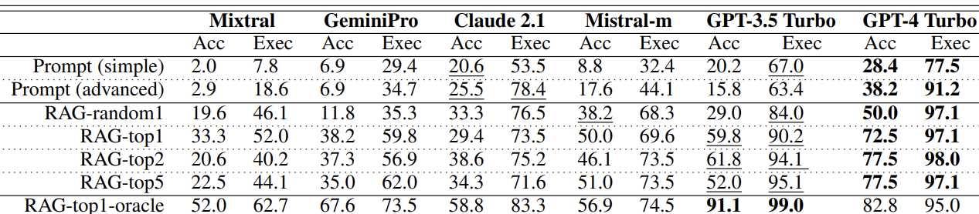
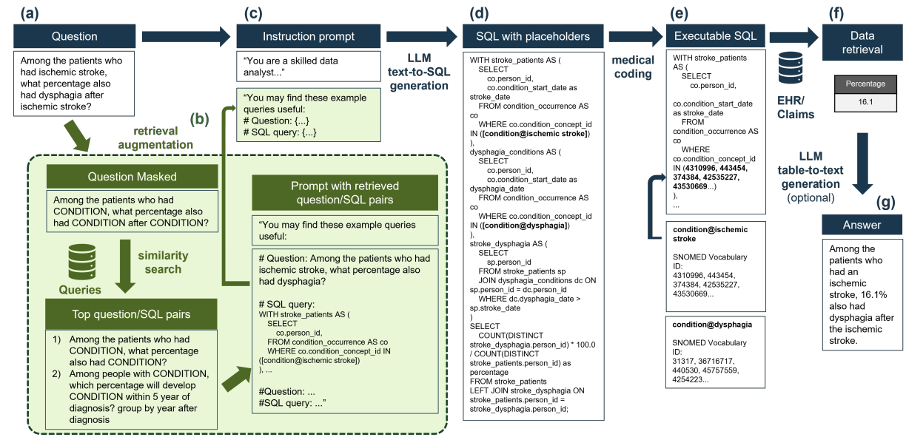
Retrieval augmented text-to-SQL generation for epidemiological question answering using electronic health records
By: Angelo Ziletti, Leonardo D’Ambrosi
TM
Problem Statement :Answering epidemiological questions from EHR data is challenging due to complex medical terminology and SQL requirements. The proposed solution aims to improve this process by using Retrieval-Augmented Generation (RAG) for text-to-SQL tasks.
Implementation :
Using LLMs like GPT-4 to generate SQL queries from questions, adding placeholders for medical entities.
Normalizing medical entities using SapBERT embeddings and GPT-4 validation.
Utilizing RAG with BGE-LARGE-EN-V1.5 to retrieve relevant question-SQL pairs.
Executing generated SQL queries on the DE-SynPUF dataset, correcting errors via compiler feedback.
Results :
:
Methodology:
Objective:
Enhance SQL generation for epidemiological questions using EHR data.
Use RAG to improve SQL generation accuracy by including relevant examples.
Fig 2 shows that Retrieval-Augmented Generation (RAG) significantly improves both accuracy and executability of SQL generation across all tested language models, with GPT-4 Turbo showing the best performance, especially when using top-retrieved examples for contextual enhancements
Conclusion :
The conclusion indicates that GPT-4 Turbo, enhanced with Retrieval-Augmented Generation (RAG), shows significant improvements in generating accurate SQL queries for epidemiological questions using EHR data. The use of RAG helps to mitigate limitations in data availability and enhances model performance in real-world settings.
Fig1. Represents the end-to-end workflow
References:
Shuaichen Chang and Eric Fosler-Lussier. 2023a. How to prompt llms for text-to-sql: A study in zero-shot, single-domain, and cross-domain settings.
Mistral AI. 2023. Generative endopoints of mistral ai. https://docs.mistral.ai/platform/endpoints/. Accessed: February 15, 2024.
Figure 1 illustrates the detailed workflow, starting with a natural language question. Retrieval augmentation retrieves similar question-SQL pairs to aid in SQL generation. The LLM then generates SQL queries containing placeholders for medical entities, which are subsequently replaced with specific clinical terms to create executable SQL. Finally, the SQL is executed on an OMOP CDM-compliant database, so that in can be converted back to natural language

Slide 11
REQUIREMENT SPECIFICATIONS
10
Functional Requirements:
Natural Language Processing (NLP): The system must accept user input in natural language and process it to generate database queries.
SQL Query Generation: Automatically generate accurate SQL queries based on the user input and knowledge from various sources.
Knowledge Retrieval: Retrieve relevant information from the knowledge store (e.g., textbooks, documents) to support query generation.
Database Interaction: Execute SQL queries on the target database and return the results to the user.
User Interface: Provide a user-friendly interface for inputting queries and viewing
Integration with Knowledge Store: The system must allow the integration of external knowledge sources, such as textbooks, for reference during query generation.
Data Retrieval and Manipulation: Support common database operations (e.g., select, insert, update, delete).
Result Presentation: Display query results in a clear and understandable format.

Slide 12
REQUIREMENT SPECIFICATIONS
11
Non-Functional Requirements:
Performance: The system must generate SQL queries and retrieve results within a reasonable time (e.g., less than 2 seconds for common queries).
Scalability: The system should handle increasing amounts of knowledge data and multiple concurrent users without significant performance degradation.
Reliability: The system should provide consistent and accurate query generation and execution.
Security: Ensure that unauthorized access to the database is prevented, and the system enforces proper user authentication and permissions.
Maintainability: The system code should be modular and maintainable for easy updates and future enhancements.
Availability: The system must be available and responsive during working hours or as defined by operational requirements (e.g., 99% uptime).
Compatibility: The system should be compatible with various database management systems (e.g., MySQL, PostgreSQL, SQL Server).

Slide 13
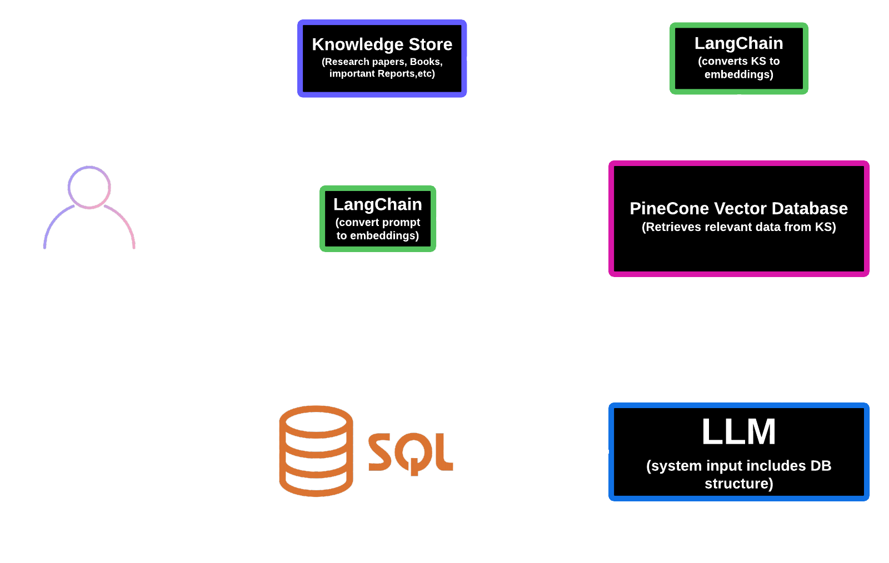
PROPOSED SYSTEM ARCHITECTURE
12

Slide 14
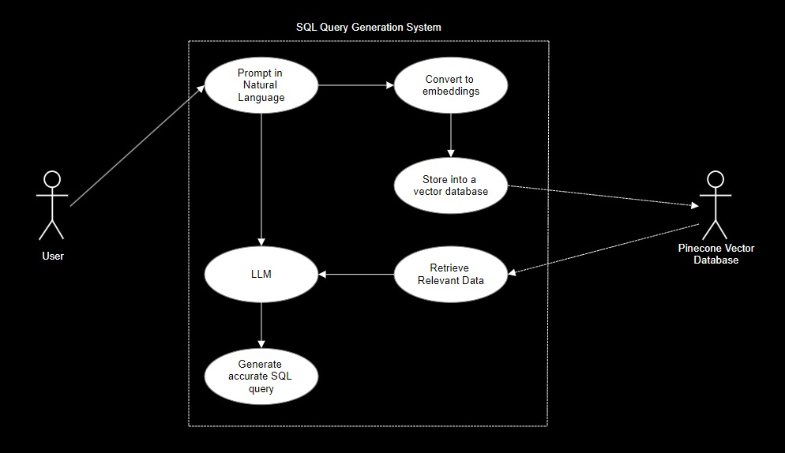
USE CASE DIAGRAM
13

Slide 15
REFERENCES
14
Shuaichen Chang and Eric Fosler-Lussier. 2023a. How to prompt llms for text-to-sql: A study in zero-shot, single-domain, and cross-domain settings.
Mistral AI. 2023. Generative endopoints of mistral ai. https://docs.mistral.ai/platform/endpoints/. Accessed: February 15, 2024
Ting Chen, Simon Kornblith, Mohammad Norouzi, and Geoffrey Hinton. 2020. A simple framework for contrastive learning of visual representations. Link
Roy De Maesschalck, Delphine Jouan-Rimbaud, and Désiré L Massart. 2000. The mahalanobis distance. Chemometrics and intelligent laboratory systems,. Link
https://arxiv.org/abs/2409.14924
Fotso, S. T. Natural Language Query Engine for Relational Databases using Generative AI (2024). arXiv:2410.07144. https://arxiv.org/abs/2410.07144
Zijin Hong and Jian Liu. 2024. Towards better ques tion generation in qa-based event extraction. arXiv preprint arXiv:2405.10517.
OpenAI. 2023. Gpt-4 technical report. arXiv preprint arXiv:2303.08774.

